Slide 1

DEPARTMENT OF INFORMATION TECHNOLOGY
Internet of Things
1

Slide 2
Topic
IoT Levels
2

Slide 3
IOT Levels
There are various levels of IOT levels
An IoT system comprises of the following components
Device
Resource
Controller service
Database
Web Service
Analysis Component
Application

Slide 4
Device
An IOT device allows identification, remote sensing, actuating and remote monitoring capabilities
Resources- Software components
that access, process and store server information or controlling actuators connected to the device
Enables network access for the device.
Controller Service
Basic service that runs on the IOT device and it interacts with the web services
Sends data to the web service from the device
Receives commands from the application ( via web services) for controlling the services.

Slide 5
Database
Can be either local or in cloud and stores the data generated by the device
Web service
Acts as a link between the IOT device , application, database and analysis components.
Implemented using HTTP and REST or Web Socket Protocol

Slide 6
Analysis Component
Responsible for analyzing the IOT data ad generate result in the form ease of use
Can be done either locally or in cloud
Results are stored locally or cloud
Application
Interface that users use to control and monitor various aspects of IOT system
Allows users to view the system states and view the processed data.

Slide 7
IoT Level 1
It has a single node/device that performs sensing and/or actuation, stores data, performs analysis and hosts the application locally.
Suited for modeling low-cost and low-complexity solutions where data involved is not big and analysis requirements are not computationally intensive
7

Slide 8
Have one sensor/ device to sense
Data to be stored locally
Data Analysis to be done locally
Monitoring/ Control can be done through an application
No complexity as the data is not huge.

Slide 9
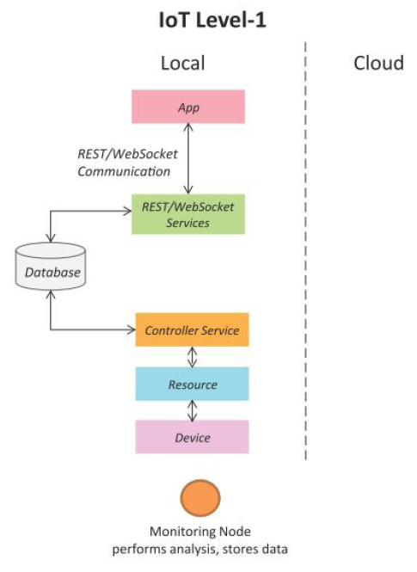
9

Slide 10
IoT Level 1
Example:
“Home Automation”
10

Slide 11
Home Automation
-> Single node allows controlling the lights and appliances in a home remotely.
-> The device (super set of node) used in this system interfaces with the lights and appliances using electronic relay switches.
-> Status information of each light / appliances is maintained in local database.
-> REST services deployed locally allow retrieving and updating the state of each light in status database.
11

Slide 12
Home Automation
->Controller service monitors the state of each light and triggers the relay switches accordingly
->Application deployed locally has a user interface for controlling lights.
->Since the device is be connected to Internet, the application can be accessed remotely
12

Slide 13
IoT Level 2
->Single node performs sensing, actuation and local analysis as shown in fig.
->Data is stored in cloud and application is usually cloud-based
->Suited for solutions where data involved is big
->Analysis is not computationally intensive and can be done locally itself
13

Slide 14
Frequency of sensing done by sensor is faster
As data is huge, cloud storage is preferred
Analysis is done locally
Controlled/ monitored through an application.

Slide 15
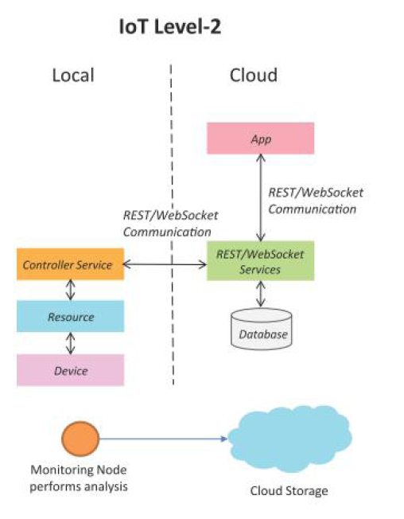
15

Slide 16
IoT Level 2
Example:
“Smart Irrigation”
16

Slide 17
Smart Irrigation
->Single node monitors soil moisture level and controls irrigation system.
->Device collects soil moisture data from sensors.
->The Controller service continuously monitors moisture level.
->If moisture level drops below a threshold, irrigation is turned on.
->Actuators – Solenoid valves can be used
->REST – for storing and retrieving moisture data which is stored in the cloud database.
17

Slide 18
Smart Irrigation
->Cloud-based app is used for visualizing the moisture levels over a period of time, which can help in making decisions about irrigation schedules
18

Slide 19
IoT Level 3
->It also has a single node.
->Data is stored & analyzed in the cloud and application is cloud-based.
->Suited where data involved is big and analysis requirements are computationally intensive.
19

Slide 20
Frequency of sensing done by sensor is faster
As data is huge, cloud storage is preferred
Analysis is done in the cloud
Controlled/ monitored through an application.

Slide 21
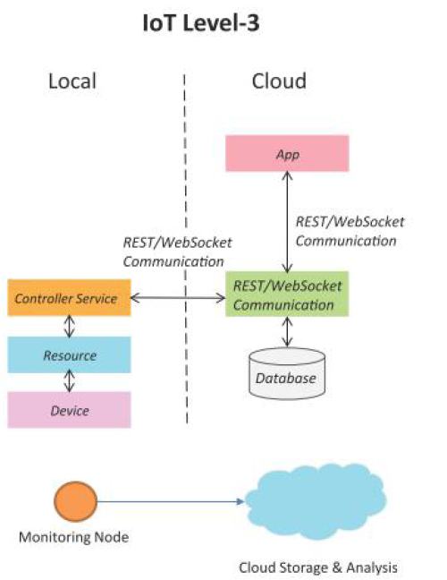
21

Slide 22
IoT Level 3
Example:
“Tracking Package Handling”
22

Slide 23
Tracking Package Handling
->Node monitors the vibration levels for a package being shipped.
->Device uses sensors for monitoring vibration levels.
->Controller service sends sensor data to cloud in real-time using WebSocket service.
->Data is stored in cloud and visualized using a cloud-based application.
->Analysis components in the cloud can trigger alerts if vibration levels become greater than a threshold.
->WebSocket service can send the sensor data to the cloud in real-time.
->Cloud-based apps can subscribe to sensor data feeds for viewing real-time data.
23

Slide 24
IoT Level 4
->It has multiple nodes that perform local analysis for various applications.
->Data is stored in cloud and application is cloud based.
->It has local & cloud-based observer nodes which can subscribe to and receive information collected in the cloud.
->Observer nodes can process information and use it for various applications.
->Observer nodes do not perform any control functions.
24

Slide 25
Multiple nodes that performs analysis
Data storage and analysis can be done in cloud.
Local and cloud based observer nodes- that process the information and use it for various purposes
do not perform any control functions.

Slide 26
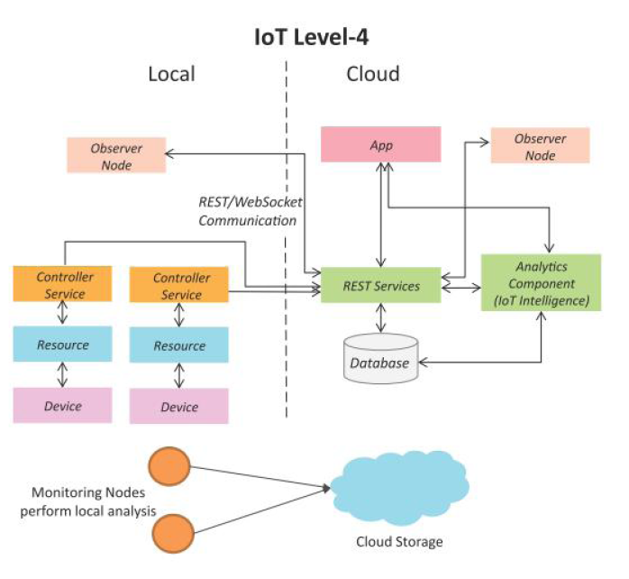
26

Slide 27
IoT Level 4
Example:
“Noise Monitoring”
27

Slide 28
Noise Monitoring
The system consists of multiple nodes placed in different locations for monitoring noise levels
The node is equipped with sound sensor and are independent to each other
Each node runs its own controller service to send the data to cloud
The data is stored in cloud and analyzed
Application is used to visualize the data.

Slide 29
IoT Level 5
->End nodes perform sensing and actuation.
->Coordinator nodes collects data from end nodes and sends to the cloud.
->Coordinator acts as a gateway that provides Internet connectivity to IoT system.
->Controller service on coordinator device sends collected data to cloud.
29

Slide 30
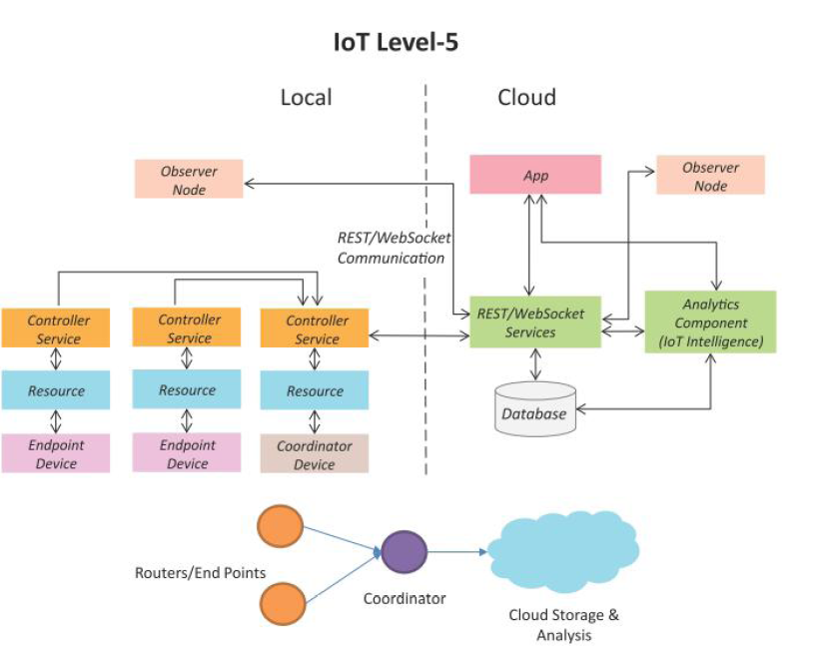
30

Slide 31
IoT Level 5
Example:
“Forest Fire Detection”
31

Slide 32
Forest Fire Detection
Multiple nodes are placed in different locations
Monitor temperature, humidity and carbondioxide levels in forest
Each node is equipped with sensor (TEMP, HUMIDITY, CO2)
Coordinator node (gateway)collects the data from the end node.
Controller service on the coordinator device sends the collected data to the cloud.
The data is stored and analyzed in cloud
Application is used to visualize the data.

Slide 33
IoT Level 6
->Multiple independent end nodes perform sensing and actuation.
->Centralized controller is aware of the status of all end nodes and sends control commands to the nodes.
33

Slide 34
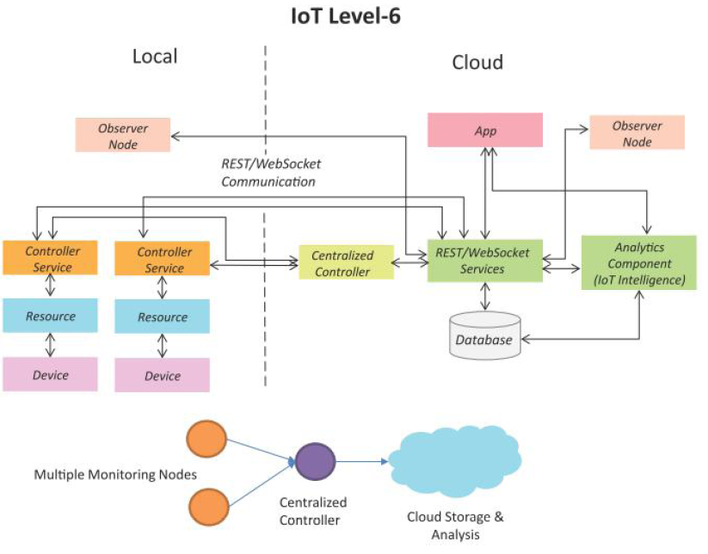
34

Slide 35
IoT Level 6
Example:
“Weather Monitoring System”
35

Slide 36
Weather Monitoring System
Multiple nodes are placed in different locations
Monitor temperature, humidity and pressure sensor.
Data stored and analysis done in cloud to aggregate the data and make predictions
A Cloud based application is used to visualize the data

Slide 37


